Slide 1


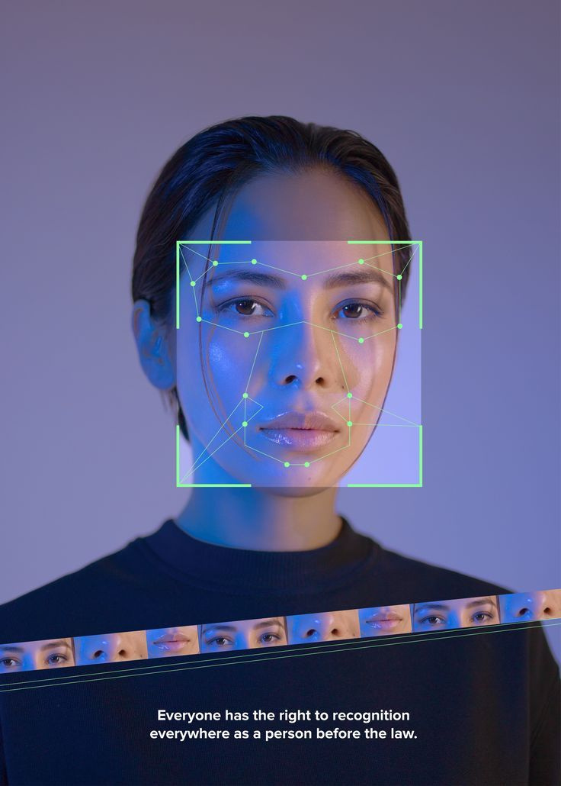

1
Presented by
Aruzhankalka Salimova, Aidin Kydyraliev, Malika Makkambai, Myktybek Abdykaiymov, Nurjamal Osmonalieva
Facial Recognition Alert System
Facial Recognition Alert System
Home Security Robotics Project
Camera → Detection → Recognition → Alert (sound + email)
Group 20

Slide 2

2
Outline
Presented by Group 20
1.Project Goal
2.Essential Theory
2.1 Face Detection
2.2 Face Recognition
3.Practical Implementation
3.1 SetUp
3.2 System Architecture
3.3 Alert Logic
4.Future Improvements
5.Conclusion

Slide 3
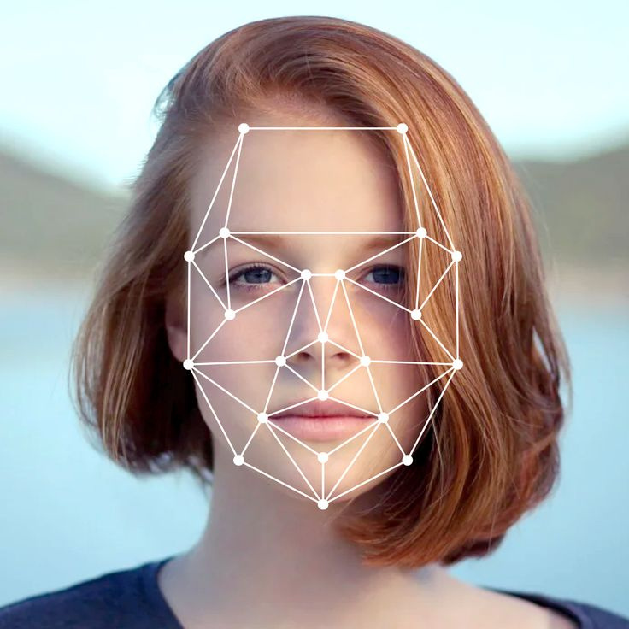
3
Presented by Group 20
Project Goal
The goal of our project is to develop a prototype door security system that:
captures live video from a camera
detects faces in real time
recognizes known individuals using a local database
triggers a sound alert and email notification for unknown persons

Slide 4

4
Presented by Group 20
Face Detection – Essential Theory
Detect faces in each frame (bounding boxes)
Crucial step before recognition
Detection errors → recognition errors → false alerts

Slide 5

5
Presented by Group 20
RetinaFace
Modern deep learning–based detector
Single-shot → fast, one pass per frame
Multi-scale → detects faces of any size
Robust in-the-wild → works with rotated faces, poor lighting, multiple faces
Predicts key facial landmarks → increases accuracy

Slide 6
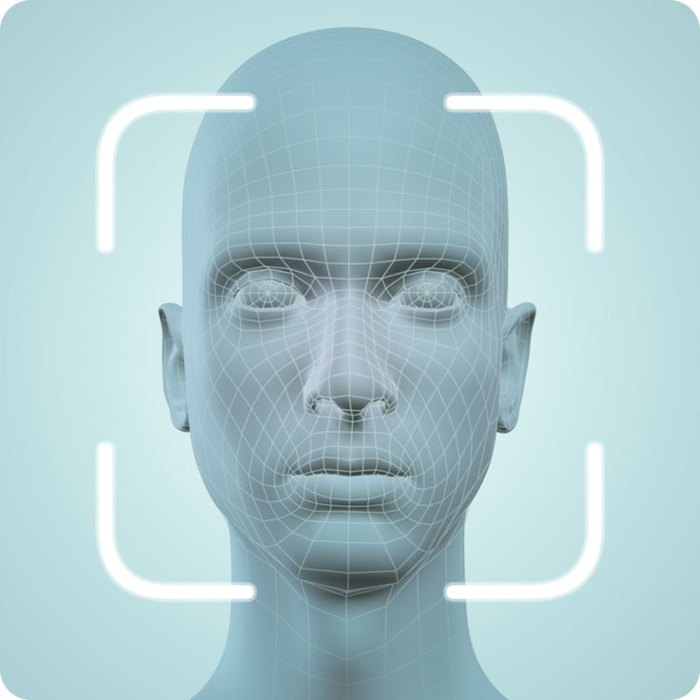
6
Presented by Group 20
RetinaFace Workscade
Point regression predicts bounding box + key points (eyes, nose, mouth)
Multi-task learning improves detection accuracy
Feature Pyramid Network detects faces at multiple scales

Slide 7
7
Presented by Group 20
Other Models We Tried
Criteria (door security):
Haar Cascade: classical, brightness-based, fast, less accurate
Dlib HOG: gradient-based, more robust to lighting than Haar, still less accurate
Tested for experiments, but final system uses RetinaFace only
Final choice: RetinaFace

Slide 8
8
Presented by Group 20
Face Detection Model Comparison
Model | Speed (CPU) | Accuracy & Robustness | Pros | Cons
OpenCV (Haar Cascade) | Very fast | Low–Medium | Fast, simple | Outdated, misses faces
dlib HOG | Slow | Medium | More robust than Haar | CPU-heavy
RetinaFace | Slowest | High | Finds almost all faces | Very slow on CPU
Final choice: RetinaFace

Slide 9
9
Presented by Group 20
FACE RECOGNITION – Essential Theory
How it works?
Detect a face in the image/video
Crop the face (focus only on the face region)
Extract a “faceprint” = a numeric vector (embedding)
Compare that embedding with a database of known embeddings
Uses embeddings + similarity distance + threshold
If distance ≤ threshold → Known
If distance > threshold → Unknown
Known identities are stored in our local database (JSON/SQLite) as embeddings/templates.

Slide 10
10
Presented by Group 20
How CNNs Create the “Faceprint” (Embedding)
CNN feature learning pipeline
Convolution layers: learn patterns from simple to complex
(edges → shapes → facial parts like eyes/nose/jawline)
Pooling layers: shrink the feature maps
(keeps strongest info, more robust to small shifts/lighting changes)
Fully-connected layers: convert learned features into a compact vector
→ the embedding (“faceprint”) used for matching

Slide 11
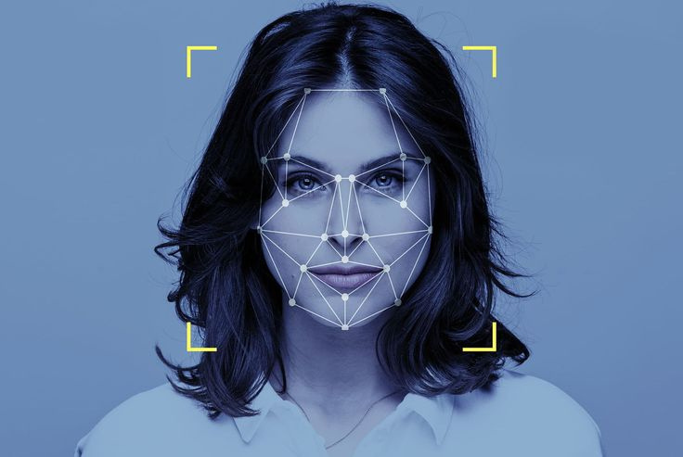

11
Presented by Group 20
ArcFace
ArcFace is a machine learning model that takes two face images as input and outputs the distance between them (threshold) to see how likely they are to be the same person.
It works as deep embedding model + Additive Angular Margin Loss to learn highly discriminative facial features.
The system compares embeddings using cosine similarity
ArcFace performance depends strongly on detection quality → reason RetinaFace helps.

Slide 12
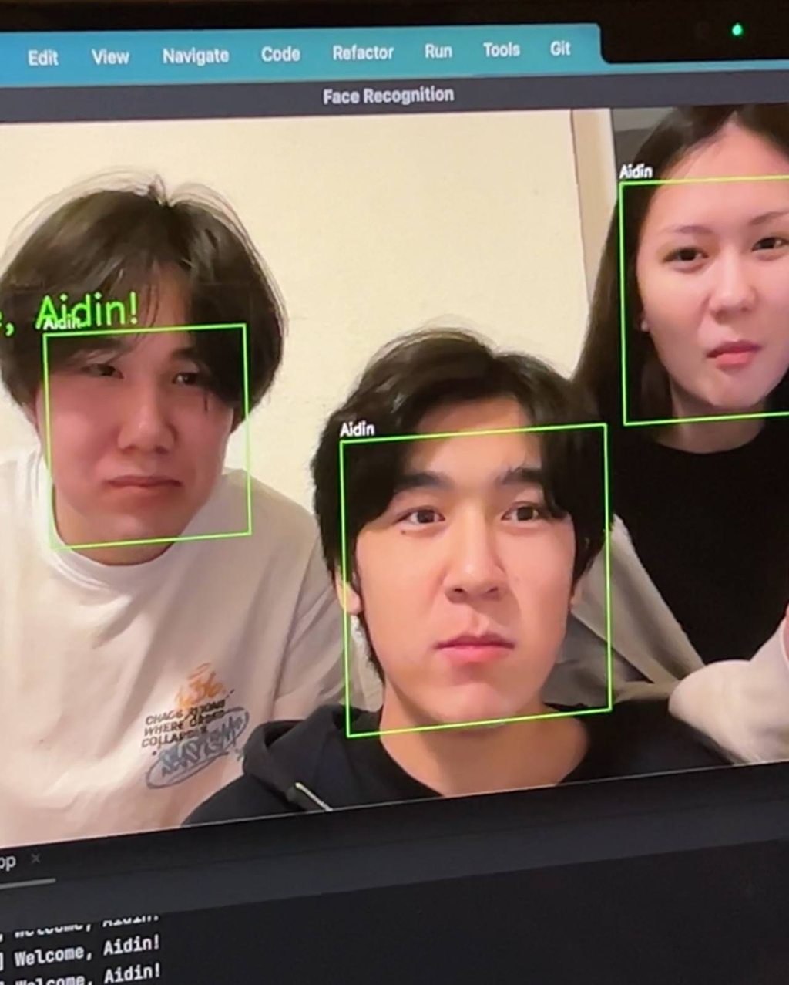
12
Presented by Group 20
Initial Problem
In the first implementation using a DeepFace CNN baseline,
the system sometimes recognized three different people as one identity.
This issue motivated us to:
analyze face detection and recognition quality
compare different models
improve identity separation using more robust embeddings

Slide 13
13
Face Detection Model Comparison
Presented by Group 20
Model | Accuracy (identity separation) | Speed on old CPU laptops | Pros | Cons | Robustness (light/pose)
Deepface (CNN model) | Medium | Faster | Simple baseline, easy to run in DeepFace framework | Can confuse similar faces, sensitive to crop quality / detector quality | Medium
ArcFace | High | Slow | Strong identity separation (margin-based training), works well with cosine distance | Heavier model → on old laptops FPS drops; on newer hardware or GPU it performs much better | High
Final choice: ArcFace

Slide 14




14
Practical Implementation
Setup
Software
Python 3.9-3.11
Libraries: opencv-python, numpy, ArcFace, retina-face, playsound,
smtplib, email.message
Hardware
Webcam
Speakers for alert
Database
JSON file with known face embeddings (gallery_db.json)
Format supports multiple embeddings per person
Email Setup
Environment variables:
ALERT_EMAIL – your Gmail
ALERT_EMAIL_PASS – app password
ALERT_TO_EMAIL – recipient
Presented by Group 20

Slide 15





15
System Architecture
Camera → Detection → Recognition → Alerts
Live video from a web camera.
Faces are detected, converted into embeddings, and classified as known or unknown.
Presented by Group 20

Slide 16
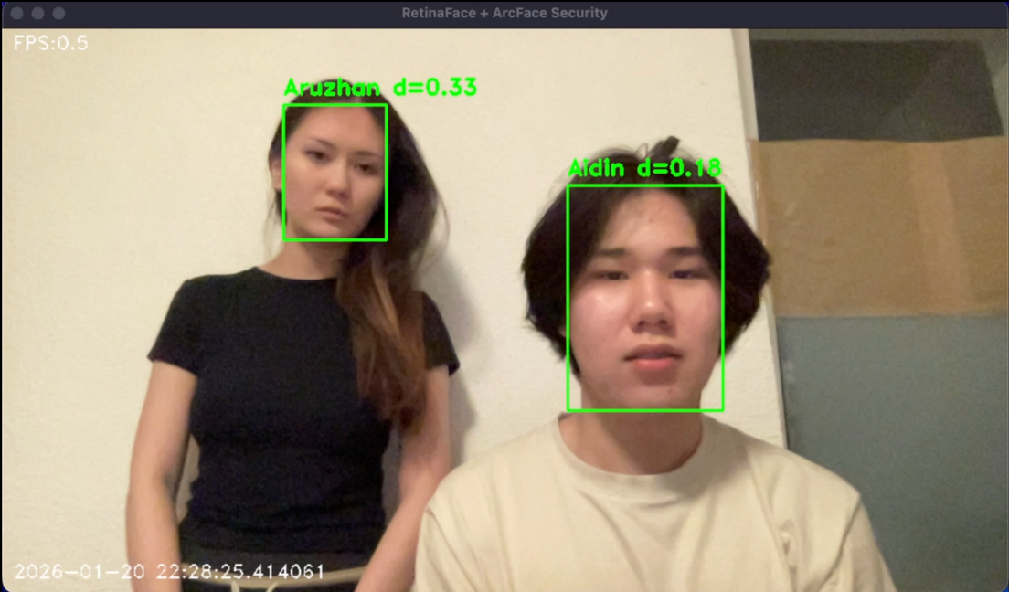
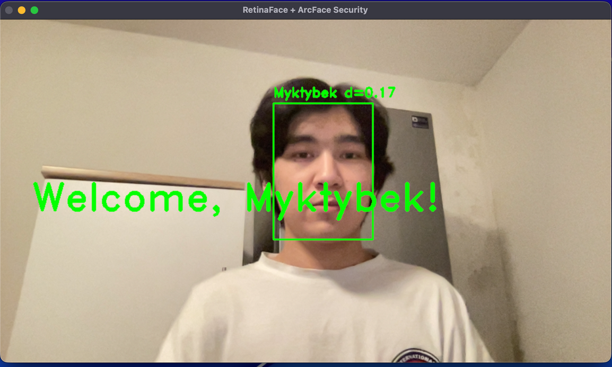
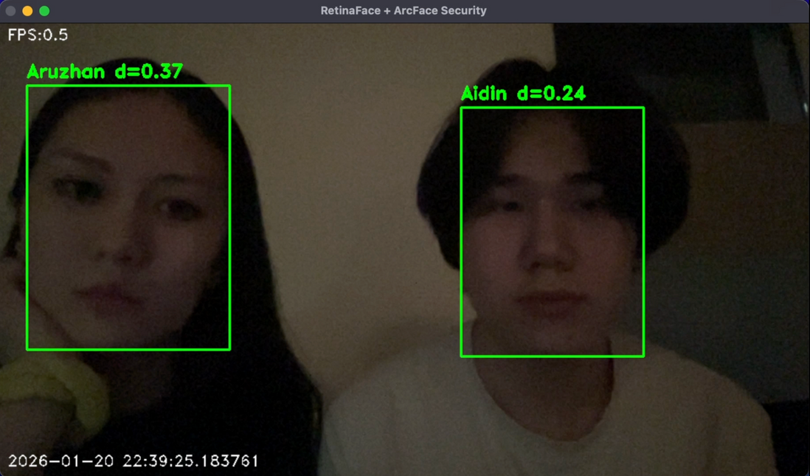
16
Alert Logic
For known person
Matched person for the next 5 seconds
Welcome + known_person_name
Presented by Group 20

Slide 17
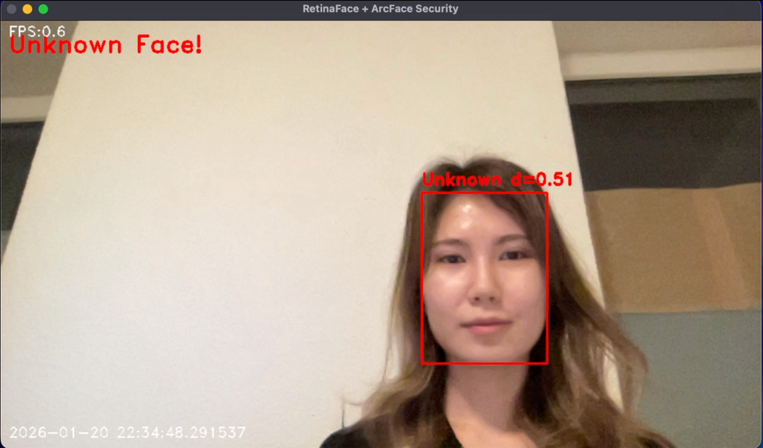
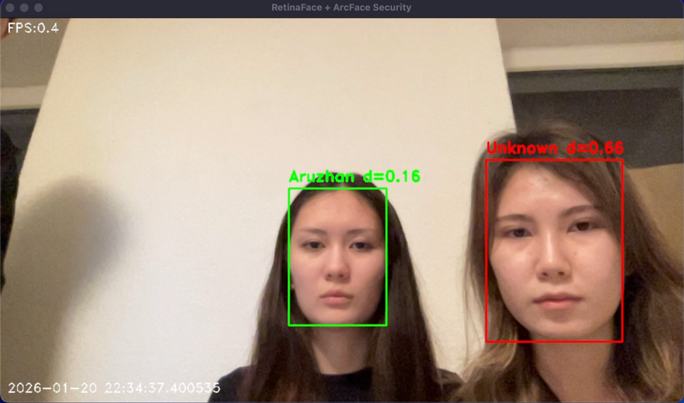
17
Alert Logic
For unknown person
Unmatched person for the next 10 seconds
Screenshot
Presented by Group 20

Slide 18
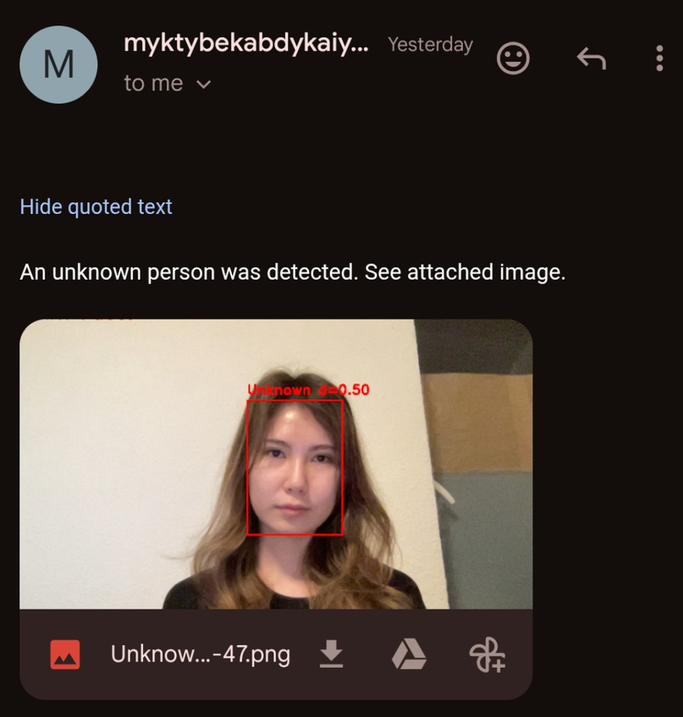
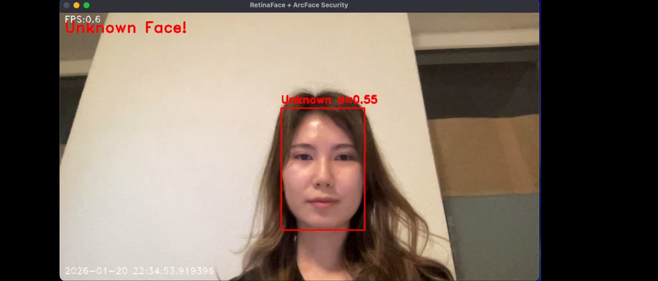
18
Alert Logic
For unknown person
Sound Alert activate
Send via email
Presented by Group 20

Slide 19
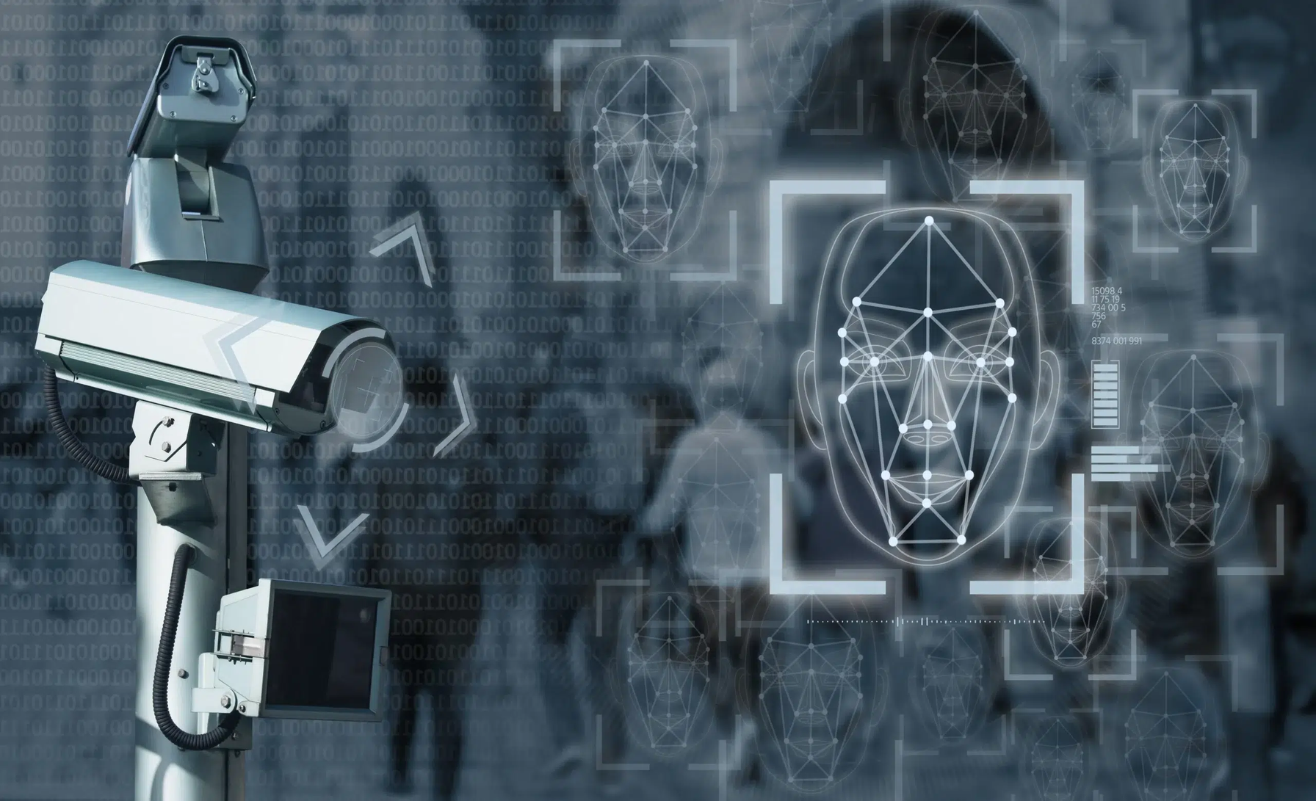
19
Presented by Group 20
Outlook/Future improvements
Replace laptop webcam with a real security camera
Tune threshold with real camera samples (reduce false matches)
Faster search in database (cache embeddings; optional SQLite later)
Add anti-spoof / liveness (future security upgrade)

Slide 20
20
Conclusion
Presented by Group 20
We developed a facial recognition–based home security prototype using a modular pipeline:
Camera → Detection → Recognition → Alert
Our comparison showed that:
Detection quality directly impacts recognition accuracy
RetinaFace provides the most reliable face detection
ArcFace embeddings achieve better identity separation than simpler models
Despite lower CPU performance, the RetinaFace + ArcFace combination significantly improved system reliability, making it suitable for real-world security scenarios.

Slide 21
21
References
Presented by Group 20
Books and Journals
Deng, J./Guo, J./Ververas, E./Kotsia, I./Zafeiriou, S.: RetinaFace: Single-Shot Multi-Level Face
Localisation in the Wild. In: Proceedings of the IEEE/CVF Conference on Computer Vision and
Pattern Recognition (CVPR). 2020, pp. 5203–5212.
Electronic Resources
Cochard, D.: ArcFace: A Machine Learning Model for Face Recognition. Medium, 2021. Available at:
[Accessed: January 20, 2026].
Khan, A.: What is Face Detection? The Ultimate Guide. LearnOpenCV, 2022. Available at:
[Accessed: January 20, 2026].
King, D.: dlib C++ Library, 2009. Available at: [Accessed: January 20, 2026].
OpenCV: Cascade Classifier — Object Detection using Haar features, 2023. Available at:
[Accessed: January 20, 2026].

Slide 22
22
Presented by Group 20
Thank you for your attention!

